Slide 1
Biathlon BC Hosting Policy
2024-25 season

Slide 2
Purpose of the Hosting Policy changes
Make our sport more accessible and inclusive
Enable growth in the sport
Align policies with Biathlon Canada and Biathlon Alberta
Better incentivise Host OC’s to run BC Cups
Adjust rules for non-IBU classes to make them more appropriate

Slide 3
Purpose of this town hall
Understand the intent of the Development 1-2, U17, and Adult classes and where they fit in the competition pathway
Understand the addition of Optical/Laser biathlon
Provide guidance on what class your athletes should compete in
Communicate other changes to the hosting policy

Slide 4
NEW Categories
Adult 1 (17+). Non-carry
Adult 1 Optical/laser (17+)
Adult 2 (17+)
Adult 3 (17+)
Adult 4 (17+)
Senior Men and Senior Women (22+)
Junior Men and Junior Women (19+)
Youth Men and Youth Women (15-18)
U17 Standing Boys and Girls (U17)
U17 Prone Boys and Girls (U17)
Development 2 (U17)
Development 2 Optical/laser (U17)
Development 1 (U17)
Development 1 Optical/laser (U17)
U11 Optical/laser (U17)
Sit-ski and visually impaired Optical/laser

Slide 5
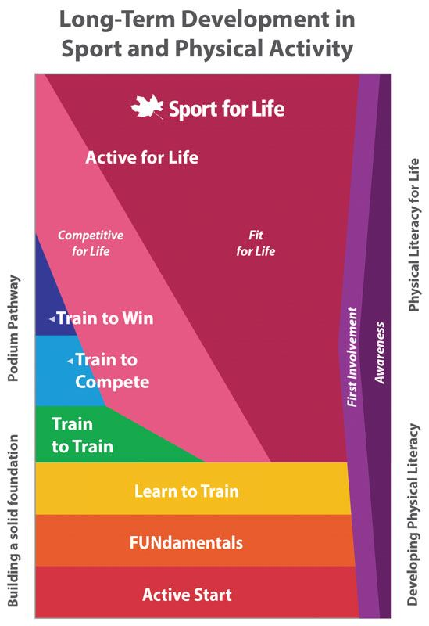
Organized Competitions
Development, U17 Classes -> Train to Train Stage
IBU Classes -> Train to Compete and Train to Win Stages
Adult Classes -> Competitive for Life Stage
Learn to Train Stage (u11) - fun, informal competitive activities with a focus on effort, learning, improvement, and friendship, instead of results

Slide 6
Development Classes
Athletes do not need a minor’s licence to compete
Prone shooting only
Rifles do not need a harness
Rifles are placed on the shooting mat by coaches
Possible to share rifles among several athletes
Optical/Laser classes for Development 1-2
Start lists should not be separated by gender or by year of birth

Slide 7
U17 Classes
A minor’s licence is recommended but not required to compete
Athletes do not carry their rifles on course
Non-carry rifle procedure can be rack to rack or the rifles can be brought to the mat by coaches
Start lists and results are separated by gender
U17 Standing
Formerly called Senior Boys and Senior Girls
Start lists and results are separated by gender
U17 Prone
New competition class with a greater emphasis on skiing performance than U17 Standing
Prone shooting only

Slide 8
Pathway to Youth Men/Women
U17 Prone
Development 1 (rest). .22 or Optical/laser
Development 2 (sling). .22 or Optical/laser
Youth Men/Women
U17 Standing
Note: all classes can be a pathway to Adult classes

Slide 9
Typical Entry Points for Athletes
U17 Prone
Development 1
Development 2
Youth Men/Women
U17 Standing
Note: Adult 1 is entry point for 17+ athletes

Slide 10
Development 1
Shortest skiing distance available
Athletes may use a rifle rest (.22 and Optical/laser)
Intended for developing or novice skiers, or for novice shooters who are not ready to shoot prone without a rest
Primarily for 11-13 year olds
Also for older kids with comparable ski speed or as an entry point to the sport
Athletes should be able to complete a 3km Sprint competition in 15-25 minutes

Slide 11
Development 2
Longer ski distances than Development 1
.22 athletes cannot use a rifle rest, Optical/Laser athletes use a rifle rest
Intended for intermediate skiers who are not yet ready for U17 Prone or U17 Standing
Primarily for 12-14 year olds
Also for older kids with comparable ski speed
Athletes should be able to complete a 4.5km Sprint competition in 15-25 minutes

Slide 12
U17 Standing Boys/Girls
Longer ski distances than Development 2
Similar or shorter ski distances than Youth Men/Women
Intended for athletes who can shoot standing but who are not yet ready to carry their rifle on course
15 and 16 year olds
14 year olds who are developed enough to shoot standing competently
Athletes should be able to complete a 6km Sprint competition in 15-25 minutes

Slide 13
U17 Prone Boys/Girls
Similar total ski distances to U17 Standing
3 shooting bouts instead of 4 in Pursuit, Mass Start, Individual
Intended for advanced skiers who are not yet ready to shoot standing in competition
15 and 16 year olds
14 year olds who are fast enough to be competitive
Athletes should be able to complete a 6km Sprint competition in 15-25 minutes

Slide 14
Youth Men / Women
Athletes who can shoot standing and carry their rifle on course
17 and 18 year olds
16 year olds who are competitive
Exceptional 15 year olds who are competitive
Athletes should be able to complete a 6km or 7.5 Sprint competition in 20-30 minutes

Slide 15
Adult 1-4 Classes
Adult 2-4 progressive increase in ski distances. Carry. Prone and standing.
Adult 1 intended for new adult (17+) biathletes
Adult 1 .22 non-carry. Prone and standing
Adult 1 Optical/laser shooting prone only off a rest
Each adult class competes against all ages and genders. Start lists should not be seperated by gender or age group.

Slide 16
U11 Class
Intent is to provide competitions for local and regional u11 athletes or athletes travelling with family to race. The intent is not to have u11’s travel across the province. U11 will not accumulate BC Cup points.
U11 is an Optical/laser only class
U11 is a mixed gender class

Slide 17
Para-Biathlon Classes
Standing para-biathletes may compete in any age-appropriate class
Sit-ski/VI athletes have their own mixed gender class, which will be exclusively optical/laser.
Sit-ski/VI class has flexibility to alter/change the course or distances to better accommodate the athletes. This would be a decision between the OC, TD, and athletes/coaches.

Slide 18
Award Specifications
Medals obtained by Biathlon BC must be awarded to the top 3 of all IBU categories, U17 Standing and U17 Prone.
If a BC Cup or BC Championships is also a nationally sanctioned race (ie. NORAM or Westerns) BiBC medals not required for IBU classes.
Medals for Adult 1-4 and Development1-2 classes can utilize Biathlon BC medals or different medals can be sourced by the OC.

Slide 19
Awards and Results
For Senior Men/Women and Junior Men/Women, results will be displayed by category and the top 3 in each category will receive a medal.
For U17 Prone Boys, U17 Prone Girls, U17 Standing Boys, U17 Standing Girls, Youth Men, and Youth Women classes, results should rank the competitors overall, display the competitor’s year of birth, and indicate their rank by year of birth.
In each of the 4 Adult classes, results should rank the competitors overall and display and rank by gender. An additional set of results shall be separated into sub-categories by gender and into three separate age groups: Sport 17-34, Masters 35-49, and Senior Masters 50+. Medals will be given to the top 3 Men and top 3 Women of each of the 4 Adult classes, irrespective of age.

Slide 20
Awards and Results
For Development 1 and 2 and Sit-Ski/VI classes, results should rank the competitors overall, display and rank by the competitors gender (Boys/Girls) and display and rank by year of birth. Awards will be given to the top 3 male and top 3 female of each category, irrespective of age.
For U11, results should rank the competitors overall, and display and rank by the competitors gender (Boys/Girls). For U11, it is recommended to not use medals as awards but to use various prizes to award the athletes in a variety of ways during the weekend. No BC Cup points are awarded to U11 classes.

Slide 21
Awards and Results
For relays, all official and unofficial relay teams will be ranked overall. However, relay medals will only be awarded to the top 3 official teams by order of finish. Official relay teams are composed of competitors from a single Biathlon BC registered Club. Competitors and clubs must be members in good standing with Biathlon Canada and Biathlon BC to be official teams.
Those individual competitors who are not BiBC members will receive BiBC medals appropriate for their placing and may be given awards and/or recognition by organizers at their discretion.
For BC U13 Championships, it is recommended to not use medals as awards but instead use various prizes to award the athletes in a variety of ways during the weekend.

Slide 22
BC Cup Points
BC Cup points shall be awarded for the following .22 and Optical /laser categories.
Adult 1 Men and Women
Adult 1 Men and Women Optical/laser
Adult 2 Men and Women
Adult 3 Men and Women
Adult 4 Men and Women
Senior Men and Senior Women
Junior Men and Junior Women
Youth Men and Youth Women
U17 Standing Boys and Girls
U17 Prone Boys and Girls
Development 2 Boys and Girls
Development 2 Boys and Girls optical/laser
Development 1 Boys and Girls
Development 1 Boys and Girls optical/laser
Para Sit/VI Boys and Girls

Slide 23
BC Cup points continued
INDIVIDUAL RANKING:
The calculation of points will follow the International Biathlon Union for all events, except relays. First place - 90 points, 2nd place – 75 pts, 3rd place – 60 pts, 4th place – 50 pts, 5th place – 45 pts, 6th place – 40 pts, 7th – 36 pts, 8th – 34 points, 9th – 32 points, 10th – 31 points, then linearly decreasing by one point down to the 40th place.
All registered BC athletes’ points will count and accumulate. Athletes who are not registered with Biathlon BC will not be ranked and will not accumulate points. U11 Boys/Girls will not get BC Cup points and will not have an individual ranking list.

Slide 24
BC Cup points continued
CLUB RANKING:
Club points will tally all competitors’ points for each club, in all classes, and through all BC Cups and BC Championships. Relay’s will count for points. Clubs must be registered member clubs to be eligible for the club ranking.
CLUB AGGREGATE AWARDS:
Club aggregate award will be presented to the top 3 registered member clubs with the highest number of BC Cup points for all of its competitors at all BC Cups during the season.

Slide 25
Other changes
Optical/laser specific rules:
off rests, shared rifles, target setting 6 for all Eco-Aim classes.
Clubs will pool rifles, targets, stands at each race
Para-biathlon class and specific rules:
Standing athlete can race any class (age dependant)
Sit/VI race Optical/laser
Course/format flexible between OC/athlete/coaches

Slide 26
Other changes continued
Rules exceptions for BC Cups vs IBU Rules
Rifle transportation procedures (placement vs racking) outlined in detail
U13 added to policy as Biathlon BC sanctioned event.
Increased number of potential events to 11 – Ind., Short Ind., Sprint, Pursuit, MS30, MS60, SSQ, SS, Relay, SMR, MR.

Slide 27
Other changes continued
Relay specific rules added: mostly around what an official team is (must be registered). Unofficial teams can also participate.
Pursuit specific rules added. Gave flexibility for Pursuit starts to be 3 or 5 seconds.

Slide 28
Other changes continued
Registration fee increase to max $45. Used to be $40 and OC’s were risking losing money in hosting events. OC’s can charge for Friday training.
Added language around OCs working with BiBC and TD in planning the event (Invitation) and during the event.

Slide 30
Category changes from old policy

Slide 31
Current Membership fee’s
Biathlon Canada Base Fees:
$10 Biathlon Bears
$10 Recreational Athlete
$40 Development
$80 Senior Girls/Boys
$80 Youth Women/Men
$80 Junior Women/Men
$80 Women/Men
$80 Sport Women/Men
$15 Coaches
$10 Officials
$10 Supporters
British Columbia Fee Adjustments:
$40 Athletes - Biathlon Bears
$40 Athletes - Development
$40 Athletes - Senior Boys/Girls
$40 Athletes - Youth Men/Women
$40 Athletes- Junior Men/Women
$40 Athletes - Men/Women
$40 Athletes - Sport
$20 Recreational Athletes
$5 Coaches
$10 Officials
$10 Supporters

